Slide 1

Methods for Causal Inference in Educational Research
Friday 19 August 2022

Slide 2

Take-away messages
Causal inference possible if
plausible causal mechanism
treatment before outcome
comparison with counterfactual
ceteris paribus
Very good counterfactuals and ceteris paribus are difficult to establish
Multiple issues such as selection bias, reverse causation, and third-variable effects prohibit causal inference

Slide 3
Overview
Recap: Rubin’s potential outcome framework
The vocabulary of experiments
Common experimental designs
Exercise: causal and non-causal research questions
Central issues of (quasi-)experimental designs

Slide 4
Rubin’s potential outcome framework
with D=0
and Y_{D=0}
with D=1
and Y_{D=1}
The impossible, ideal experiment
In parallel universes where the same individual is once treated and once not treated, nothing differs except the treatment and outcome (ceteris paribus/other things equal)
What would have been (potential outcome or counterfactual)?
Then, the difference Y_{D=1} - Y_{D=0} reflects the causal effect of D on Y
Rubin, 1974

Slide 5
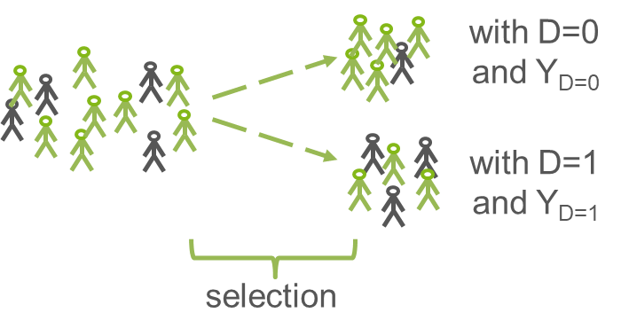
Rubin’s potential outcome framework
In reality, we need to compare groups
E[Y_{1,i}|D_{i}=1] - E[Y_{0,i}|D_{i}=0]
Difference between treatment and control group only reflects effect of D, if other things are equal (ceteris paribus)
If selection into groups relates to something that is also relevant for the outcome, difference between groups reflects causal effect and selection bias
Rubin, 1974

Slide 6


Rubin’s potential outcome framework
selection
bias!
In other words, selection bias means that we compare apples and oranges!

Slide 7
Rubin’s potential outcome framework
selection
bias!
Example:
Negative correlation between private tutoring and mathematics achievement

Slide 8
Correlation ≠ Causation (!)
Why does correlation not prove causation?
maybe we don’t know which variable came first (e.g., reverse causation)
maybe, there is no true association, at all (e.g., spurious correlation)
maybe, there are other explanations (e.g., third-variable effect, confounding, selection bias)
D
Y
D
Y
D
Y
Campfire example
Z

Slide 9
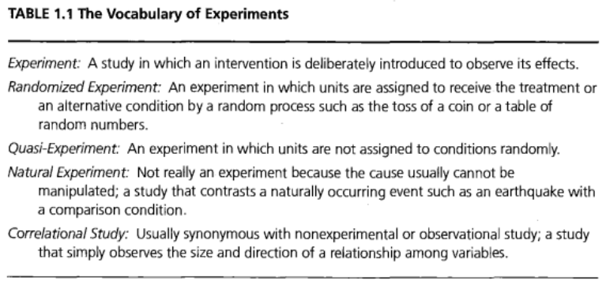
The vocabulary of experiments
Shadish, Cook, & Campbell, 2002, p. 12

Slide 10
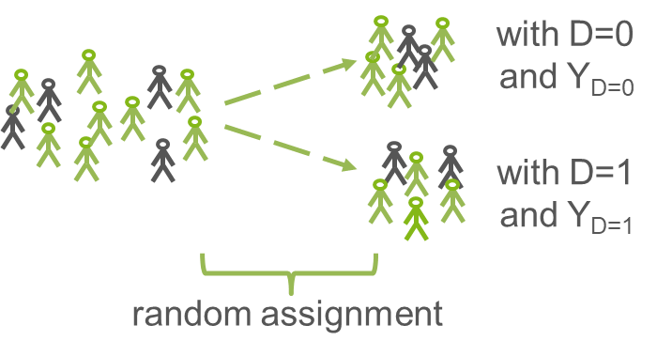
The vocabulary of experiments: randomized experiment
creation of manipulable treatment and control condition
randomized allocation to treatment vs. control
if number of units large enough, randomization effectively balances the groups
if randomization is successful, the two groups should not differ in anything but the treatment → ceteris paribus
Shadish, Cook, & Campbell, 2002

Slide 11
The vocabulary of experiments: randomized experiment
creation of manipulable treatment and control condition
randomized allocation to treatment vs. control
if number of units large enough, randomization effectively balances the groups
if randomization is successful, the two groups should not differ in anything but the treatment → ceteris paribus
selection
bias!
Shadish, Cook, & Campbell, 2002

Slide 12
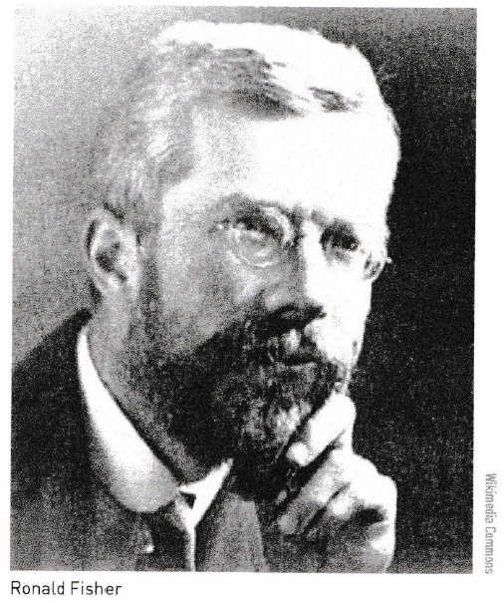
The vocabulary of experiments: randomized experiment
A famous example: Fields and fertilizers
Controlled randomized trials to find best fertilizers
Ronald Aylmer Fisher, agricultural scientist, 1920s and 1930s
Before Fisher, Rothamsted Agricultural Experimental Station in England tested one fertilizer each year → confounding with weather etc.
Fisher revolutionized this practice
division of fields into sections
randomized allocation of fertilizers to sections
controlled repeated measures of effects
statistical tests for significance
Founding father of randomized experiments (and ANOVA, F-test, p-values, etc.)
Coleman, 2019, pp. 28-30

Slide 13
The vocabulary of experiments: quasi-experiment
creation of manipulable treatment and control condition
but no randomized allocation to treatment vs. control
instead, self-selection or administrator selection (e.g., teachers, bureaucrats,...) → selection bias threat
however, one can still try to make treatment and control group comparable
Shadish, Cook, & Campbell, 2002

Slide 14
The vocabulary of experiments: quasi-experiment
creation of manipulable treatment and control condition
but no randomized allocation to treatment vs. control
instead, self-selection or administrator selection (e.g., teachers, bureaucrats,...) → selection bias threat
however, one can still try to make treatment and control group comparable
?
selection
bias!
Shadish, Cook, & Campbell, 2002

Slide 15
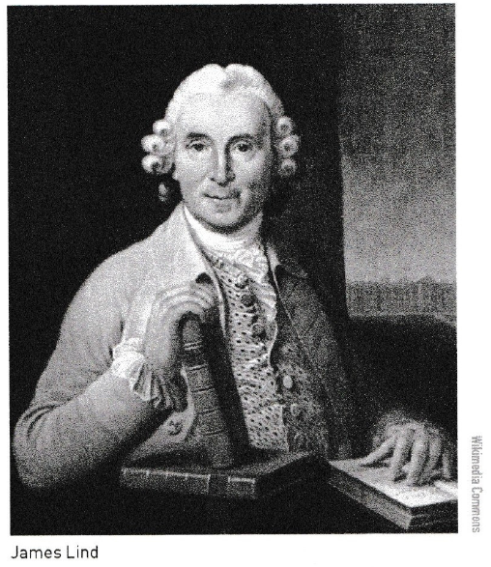
The vocabulary of experiments: quasi-experiment
A famous example: The scurvy studies
Controlled experiment to find cure against scurvy
James Lind, ship surgeon, 1747
12 sailors with scurvy allocated to 6 treatment groups (matching based on age, health, etc.):
quart of cider
sulphuric acid
half pint of seawater
mixture of garlic, mustard and horseradish
vinegar
two oranges and a lemon
Otherwise similar conditions
Both men in fruit group recovered after 6 days
Conclusion that vitamin C cures scurvy
Coleman, 2019, pp. 24-27

Slide 16
The vocabulary of experiments: natural experiment
natural treatment and comparison conditions; often not manipulable
complex and often intransparent selection mechanisms → selection bias threat
however, meaningful comparisons can be made depending on the comparison conditions
?
selection
bias!
Shadish, Cook, & Campbell, 2002

Slide 17
The vocabulary of experiments: non-experimental designs
correlational design, passive observational design, or non-experimental design → selection bias threat
often, all variables assessed at the same time, so unclear if treatment precedes outcome
assumptions about causal mechanisms, but difficult to rule out other explanations for correlations
?
selection
bias!
Shadish, Cook, & Campbell, 2002

Slide 18
Common experimental designs
What are treatment and outcome of interest?
What is the exact population of interest?
When and how often should an outcome be observed?
What are treatment and control/comparison conditions?
…
Shadish, Cook, & Campbell, 2002
Notes:
lower order e.g., students, higher order e.g., classrooms

Slide 19
Common experimental designs
What are treatment and outcome of interest?
What is the exact population of interest?
When and how often should an outcome be observed?
What are treatment and control/comparison conditions?
…
What is the assumed causal mechanism, i.e., which conditions do we have to observe?
How can we assign or how are units assigned to groups?
How large should my sample size be (depends on expected effect sizes, number of compared groups, quality and reliability of measures, lower or higher order units for assignment, etc.)?
…
Shadish, Cook, & Campbell, 2002
Notes:
lower order e.g., students, higher order e.g., classrooms

Slide 20
Common experimental designs
Basic Control Group Design
T1
D = 0
A
T1
D = 1
Time

Slide 21
Common experimental designs
Pretest-Posttest Control Group Design
→ Pretests are highly recommended
T2
D = 0
A
T1
T2
D = 1
Time

Slide 22
Common experimental designs
Pretest-Posttest Control Group Design with Follow-Up
T2
T3
D = 0
A
T1
T2
T3
D = 1
Time

Slide 23
Common experimental designs
Pretest-Posttest Design with Follow-Up and Two Treatments
T2
T3
D1 = 1
A
T1
T2
T3
D2 = 1
Time

Slide 24
Common experimental designs
Pretest-Posttest Design with Follow-Up and Multiple Treatments
T2
T3
D1 = 1
A
T1
T2
T3
D2 = 1
T2
T3
D3 = 1
Time

Slide 25
Common experimental designs
Pretest-Posttest Design with Follow-Up and Factorial
Treatment Design
T2
T3
D1 = 0
D2 = 0
A
T1
T2
T3
D1 = 0
D2 = 1
T2
T3
D1 = 1
D2 = 0
T2
T3
D1 = 1
D2 = 1

Slide 26
Common experimental designs
Cross-Over Design with Pretest
T2
T3
D1 = 1
D2 = 1
A
T1
T2
T3
D2 = 1
D1 = 1
Time

Slide 27

Group exercise
What are examples for causal research questions (i.e., that could be studied in (quasi-)experiments)?
What are examples for non-causal research questions (i.e., that could not be studied in (quasi-)experiments)?

Slide 28
Central issues of (quasi-)experiments
Only suitable for cause-and-effect research questions, not for questions like
what is the cause of a phenomenon?
why should there be an association between phenomena (i.e., theory-building)?
what is the nature of a phenomenon (i.e., descriptive questions)?
…
Shadish, Cook, & Campbell, 2002

Slide 29
Central issues of (quasi-)experiments
Only suitable for cause-and-effect research questions, not for questions like
what is the cause of a phenomenon?
why should there be an association between phenomena (i.e., theory-building)?
what is the nature of a phenomenon?
…
causal description (e.g., if I hold a match to dry leafs, they catch fire) vs. causal explanation (e.g., why and under which exact conditions does a match light leafs?)
→ importance of meaningful potential causal mechanisms
→ importance of consecutive fine-grained experiments and observations (incl. moderators, mediators)
Shadish, Cook, & Campbell, 2002

Slide 30
Central issues of (quasi-)experiments
Randomized experiments often not feasible for ethical (e.g., depriving students of schooling) or feasibility reasons (e.g., random assignment to school types). But even if they are
non-compliance issues (e.g., treatment units refuse treatment; control units get treatment anyway) → choice of comparison conditions and level of units
not all treatments are manipulable (e.g., gender) → careful choice of treatment (e.g., vignette studies)
attrition issues, especially in control groups → choice of comparison conditions, cross-over designs
treatment diffusion (e.g., less time with learning software than intended) → implementation checks
randomization is incorrectly or incompletely implemented, not enough cases (e.g., if deck of cards is shuffled, some players still get better cards) → balance checks, power analyses
Shadish, Cook, & Campbell, 2002

Slide 31
Central issues of (quasi-)experiments
3. Quasi-experimental designs can still suffer from selection bias (!)
is selection mechanism known?
can selection mechanism be methodologically accounted for?
are treatment and comparison conditions really comparable, except for the treatment (i.e., ceteris paribus)?
can we speculate about the size and directionality of unaccounted selection bias?
Shadish, Cook, & Campbell, 2002

Slide 32
Central issues of (quasi-)experiments
Generalizability
Making treatment and comparison conditions comparable implies that effects are investigated under very specific conditions → difficulty of broad interpretations
Would treatment be implemented similarly under other, more natural circumstances? Would treatment work in same way under other circumstances? → ecological validity questionable; importance of replication studies
Would we observe same effects under other circumstances? → importance of replication studies; importance of (non-convenience/probability) sampling strategies
Or good reasons to believe that we would observe something else under specific other circumstances? → “Grounded Theory of Causal Generalization”
To which degree are experimental and target generalized conditions comparable?
Which features do and do not matter for generalizability (probably)?
What are values in the variables that could have occured but did not occur?
Develop and test explanatory theories about the pattern of effects, causes, and mediational processes
Shadish, Cook, & Campbell, 2002

Slide 33
Take-away messages
(Quasi-)experiments have the potential to answer causal research questions, but not others
Selection bias, feasibility, implementation, and generalization are the most central issues in (quasi-)experiments

Slide 34
References
Angrist, J. & Pischke, J.-S. (2015). Mastering `Metrics: The Path from Cause to Effect. Princeton University Press
Coleman, R. (2019). Designing experiments for the social sciences. Sage
Rubin, D. B. (1974). Estimating causal effects of treatments in randomized and nonrandomized studies. Journal of Educational Psychology, 66(5), 688–701
Shadish, W. R., Cook, T. D., & Campbell, D. T. (2002). Experimental and quasi-experimental designs for generalized causal inference. Mifflin and Company

